Slide 1

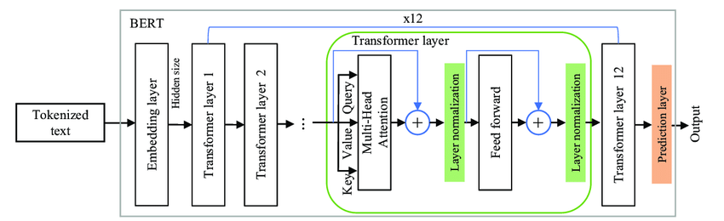
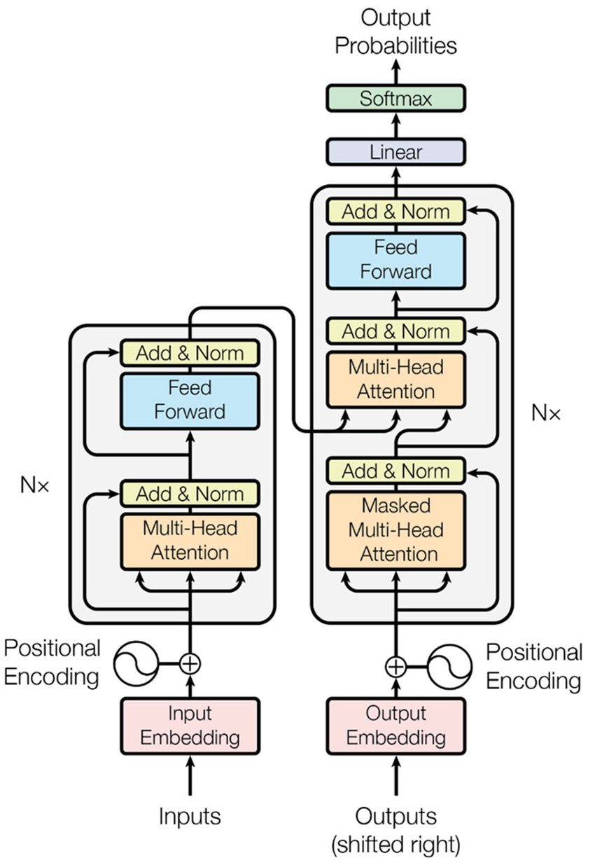
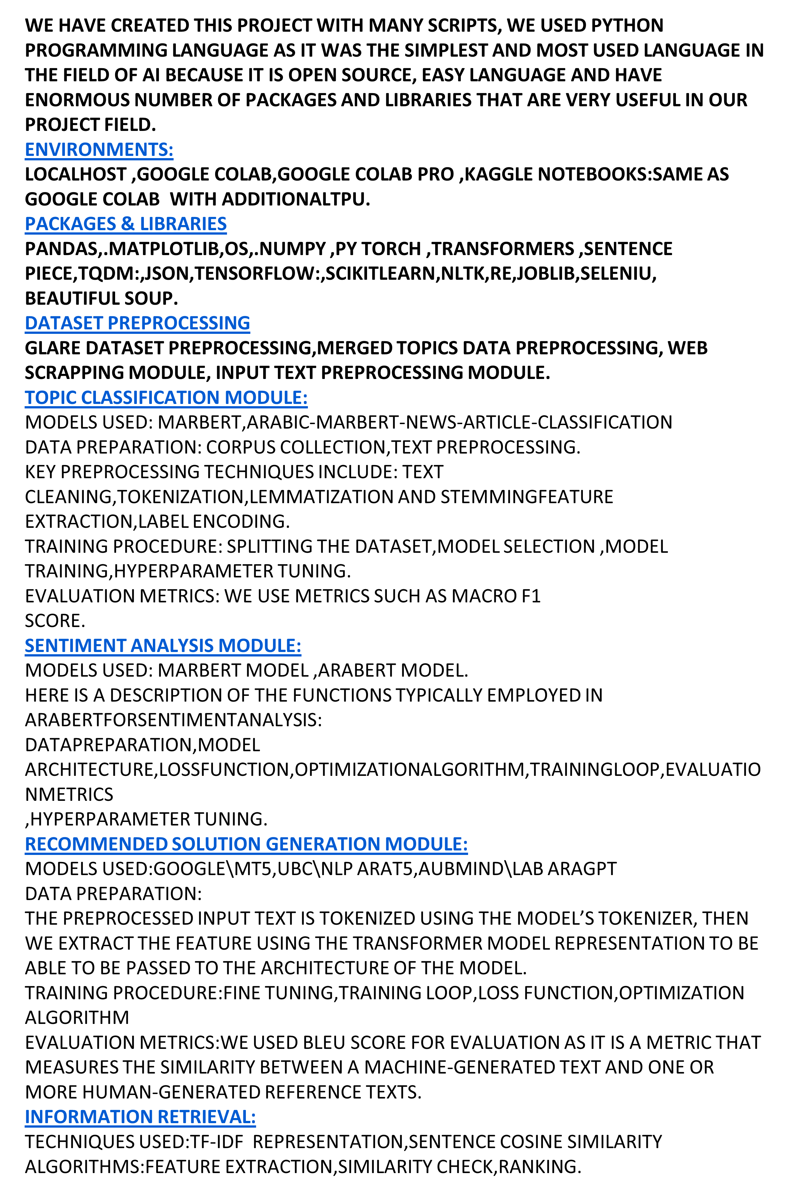
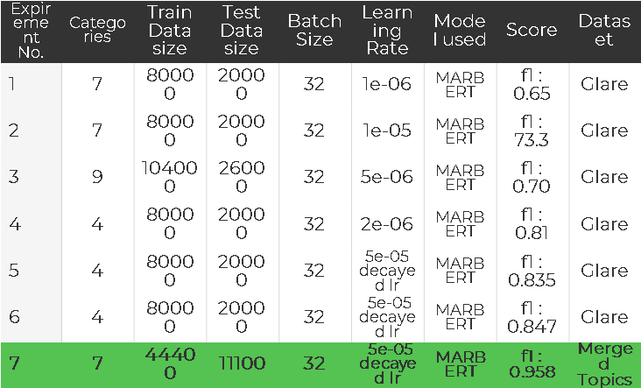
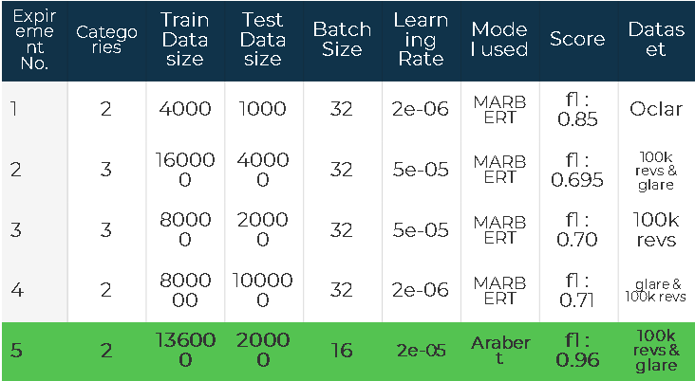
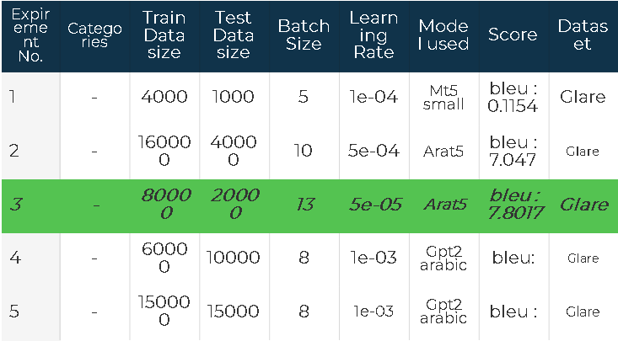


Service Quality AI Based System
Supervised by : Dr Ahmed Salah , T.A Moataz Mohamed
ABSTRACT
INTRODUCTION
RESULTS
The concept of smart government has been gaining momentum in recent years, as governments around the world strive to improve service delivery and enhance citizen engagement with technology. In this context, the Smart Government Service Quality Project represents an innovative and ambitious initiative aimed at improving the quality of government services and enhancing citizen satisfaction. Our project has applied the target desired from smart government service quality idea as we have deployed many AI NLP-based techniques as topic classification, sentiment analysis, text generation and information retrieval, these techniques allowed us to analyze reviews, complains and feedbacks of citizens in order to get desired outputs automatically without need of human participating, these outputs includes: the ministry responsible for the review, the sentiment of the citizen posting the review, the specific governmental sector responsible for the problem in the review and the recommended solution for the problem in the review. We have deployed a website to make it easy for every citizen to use it from his house, work, or any place with the internet. We have applied fine tuning for transformer models like MARBERT , Arabert, Arat5, MT5 on our downstream tasks, we have reached 0.96 f1 score in sentiment analysis task, 0.957 f1 score in topic classification task and 7.8 BLEU score in text generation task.
The Smart Government Service Quality Project is an innovative initiative aimed at improving the quality of government services through the use of advanced technologies.
The project leverages data analytics, artificial intelligence, and other smart technologies to optimize government service delivery processes, reduce bureaucracy, enhance transparency, and increase citizen satisfaction.
The project is based on a customer-centric approach that puts citizen needs and preferences at the center of service delivery. Through this approach, the project seeks to transform the way governments deliver services, making them more efficient, effective, and responsive to the needs of citizens.
Topic classification
After large number of experiments using different models, applying different text preprocessing, and applying hyperparameter tuning we concluded that experiment 7 using marbert model and preprocessed Merged topics dataset gives the best f1 score as shown in table 4.
Sentiment Analysis
After large number of experiments using different models, applying different text preprocessing and applying hyperparameter tuning we concluded that experiment 5
using arabert model and preprocessed combination between 100k reviews dataset and glare dataset, gives the best f1 score as shown in table 5.
Text Generation
After large number of experiments using different models, applying different text preprocessing and applying hyperparameter tuning we concluded that experiment 3
using arat5 model and preprocessed glare dataset, gives the best bleu score as shown in table 6.
Information Retrieval
Here are some outputs from our algorithm shown in figure 38, figure39 .
Acknowledgements
We would like to use this opportunity to express our gratitude to everyone who supported this project. We are thankful for their indispensable guidance, invaluably constructive criticism, friendly advice, and the most obliged provision of their genuine and illuminating views.We would like to offer our special thanks to our supervisor Dr. Ahmed Salah for his help and support.We would also like to extend our thanks to T.A. Moataz Mohamed for guiding and helping us throughout the whole course of the project; his help was invaluable to us.
METHODS AND MATERIALS
CONCLUSIONS
The Smart Government Service Quality Project is an important initiative aimed at improving the quality of government services through the use of smart technologies. By leveraging data analytics, artificial intelligence, and other advanced technologies, this project can help governments to identify and address service delivery bottlenecks, reduce bureaucracy, enhance transparency, and increase citizen satisfaction. With its focus on continuous improvement and innovation, this project has the potential to transform the way governments deliver services, making them more efficient, effective, and responsive to the needs of citizens.The project can be able to automatically analyze the text reviews of citizens and get the topic(ministry) of the review, the sentiment of citizen writing the review, the governmental sector responsible for the review content and recommend solutions for the problems in the review.In this project we reached best scores in topic classification with 0.957 f1 score, in sentiment analysis with 0.96 f1 score, in generating the solution and sector for the review with reasonable solutions coming from the database of known services for the government.
Table 4.
Table 5.
Table 6.
CONTACT
Amr Ayman Ahmed Samir
Youssef Mohammed Mostafa Gamal Ali Fathy Ziad El Sayed
Ain shams University amr2018170267@cis.asu.edu.eg
REFERENCES
Figure 38.
[1]Abdul-Mageed, M., Elmadany, A. and Nagoudi, E.M.B., 2020. ARBERT & MARBERT: deep bidirectional transformers for Arabic. arXiv preprint arXiv:2101.01785.
[2]Antoun, W., Baly, F. and Hajj, H., 2020. Arabert: Transformer-based model for arabic language understanding. arXiv preprint arXiv:2003.00104.
Figure 39.

